Slide 1
Team 516
Lunar Dust Glovebox
Mina Brahmbhatt, Nia Britton, Ryan Dreibelbis, Kendall Kovacs, Peter Mougey, Lawrence Terrell
October 15, 2024

Slide 2
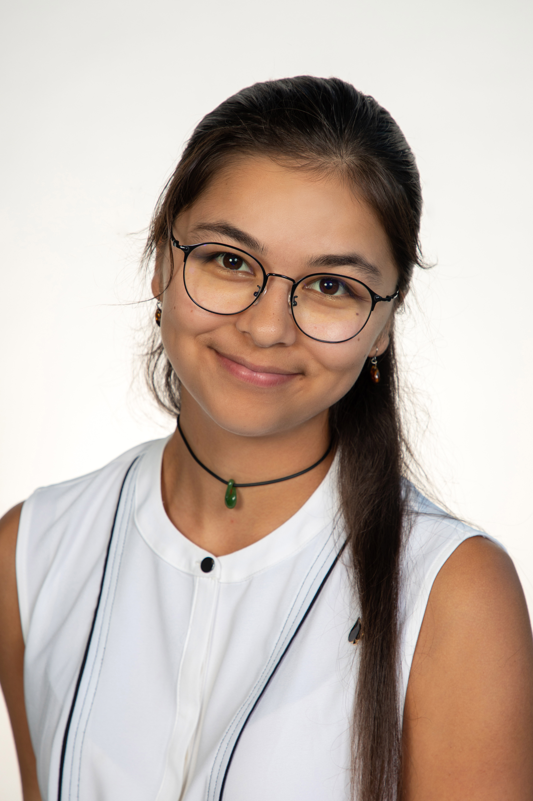
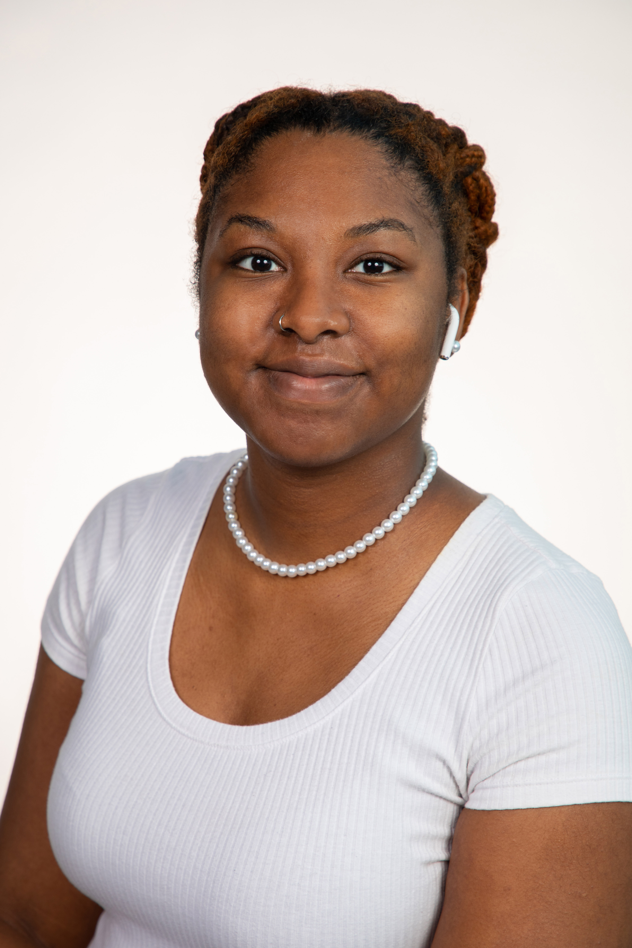
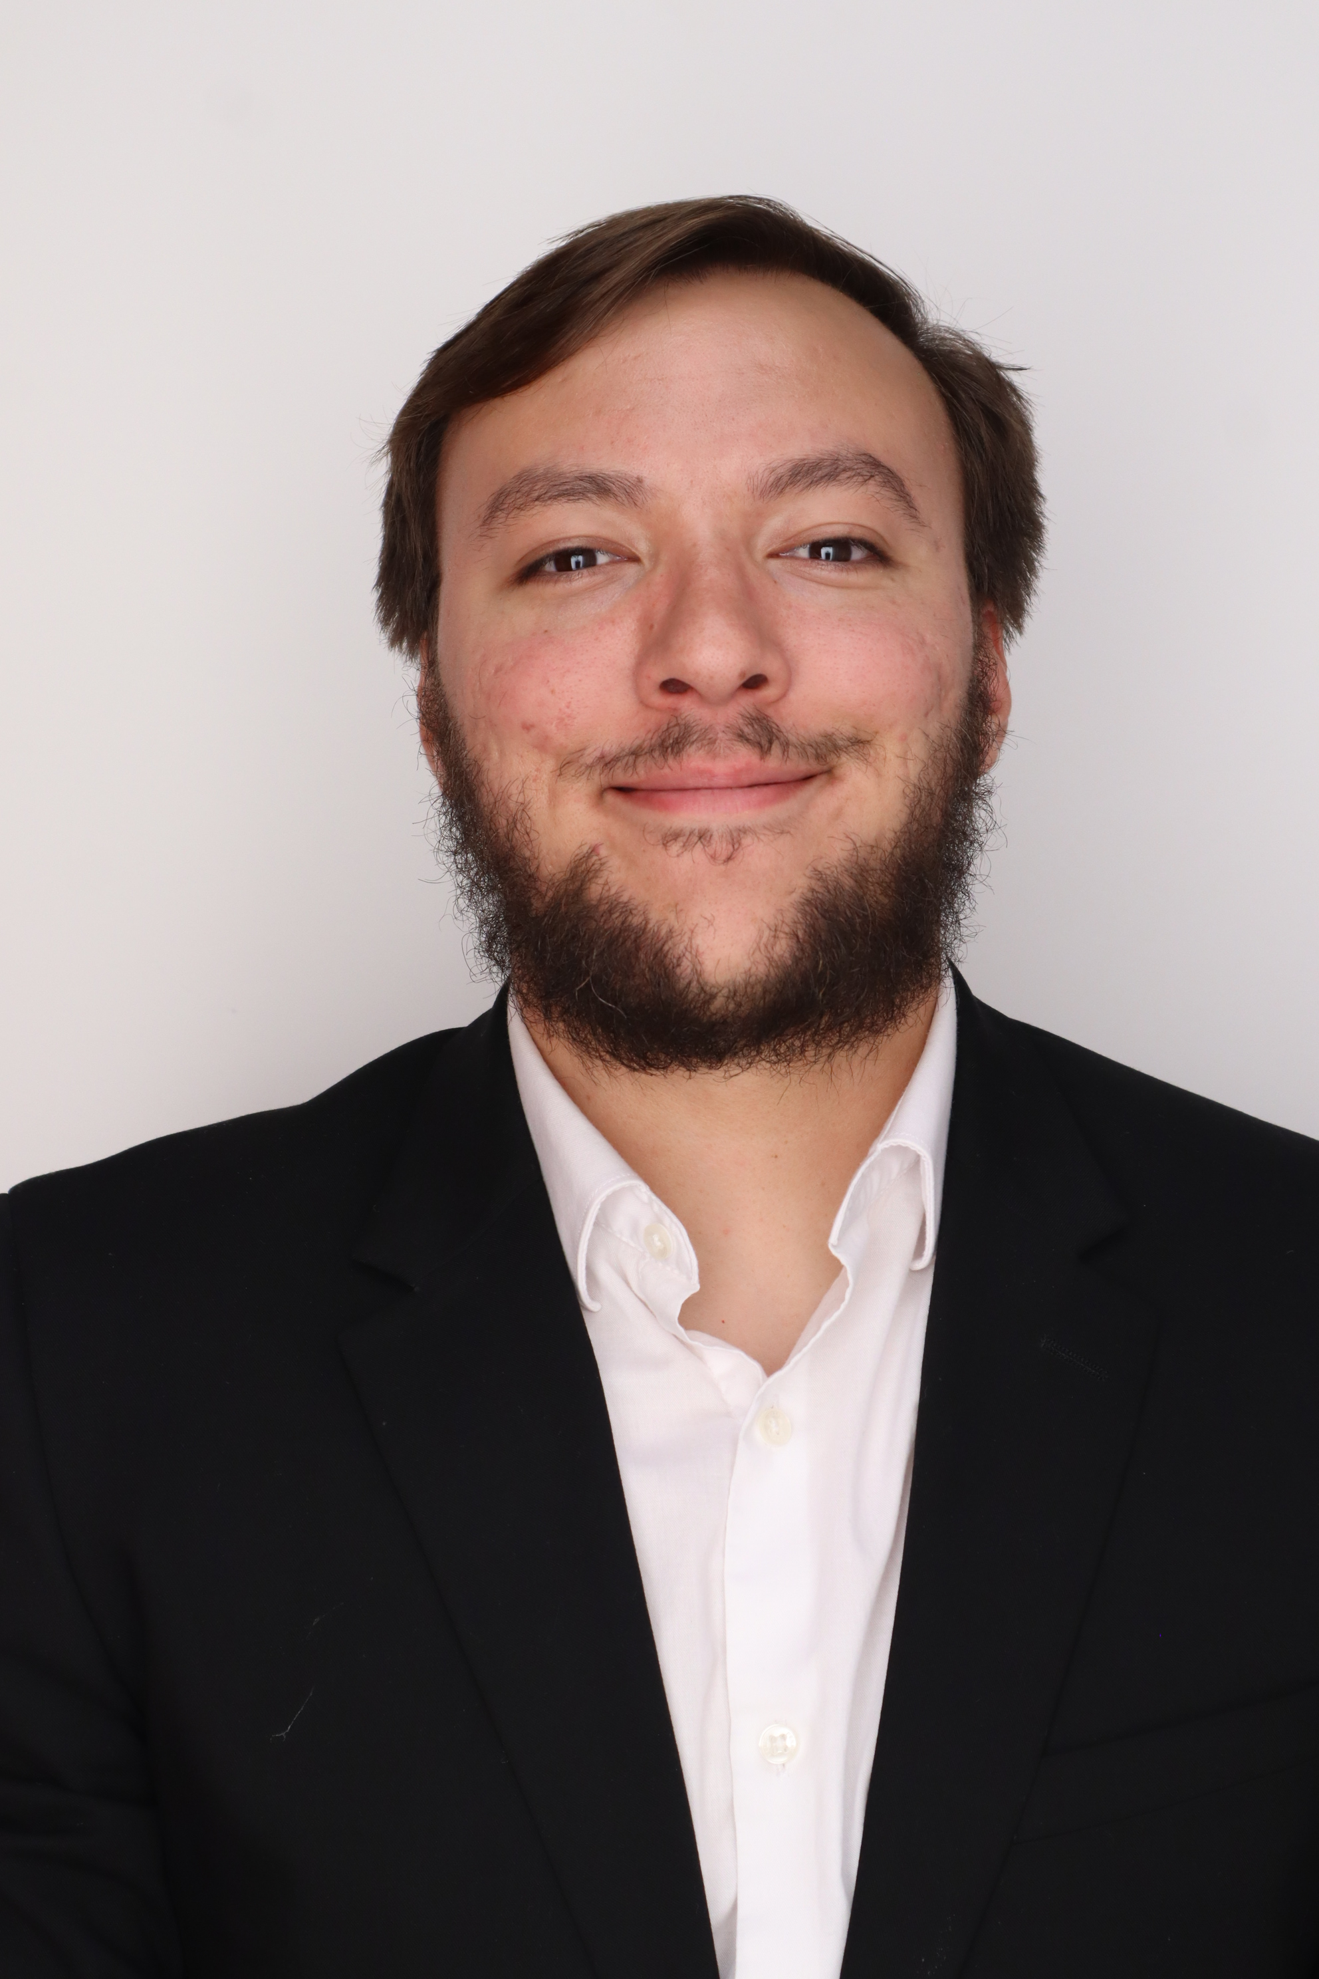
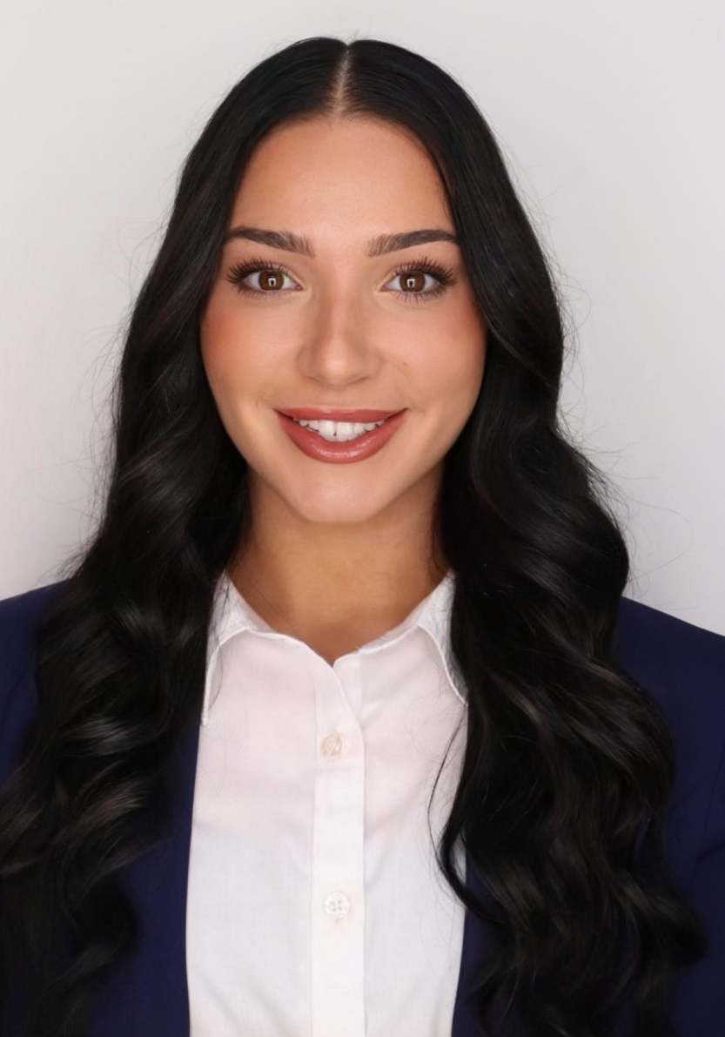
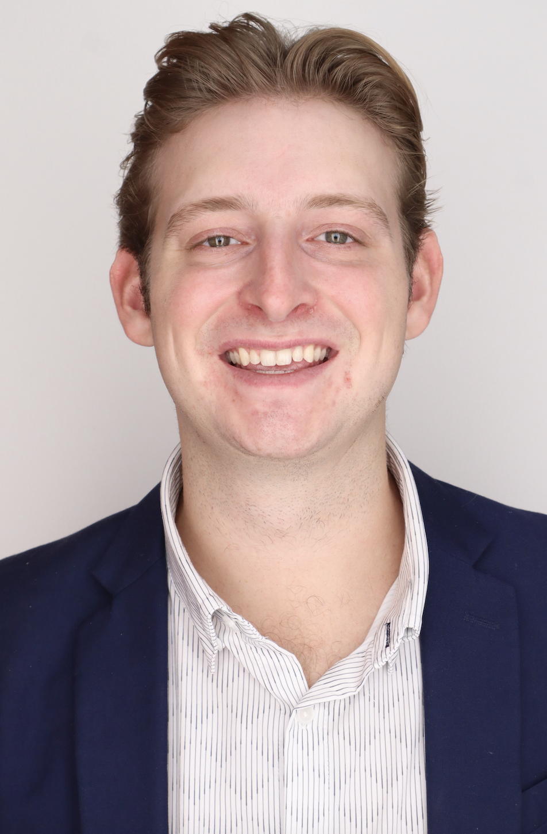

Our Team:
Everyone
Nia Britton
Quality & Design Engineer
Kendall Kovacs
Project & Test Engineer, Point of Contact
Lawrence Terrell
Simulation & Fluids Engineer
Mina Brahmbhatt
Materials Scientist
Ryan Dreibelbis
Systems Engineer
Peter Mougey
Manufacture & Design Engineer

Slide 3
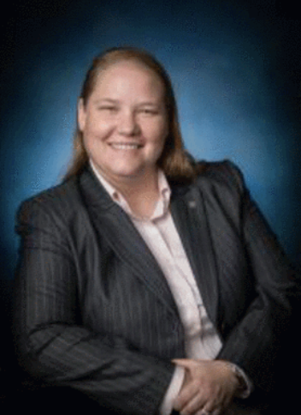
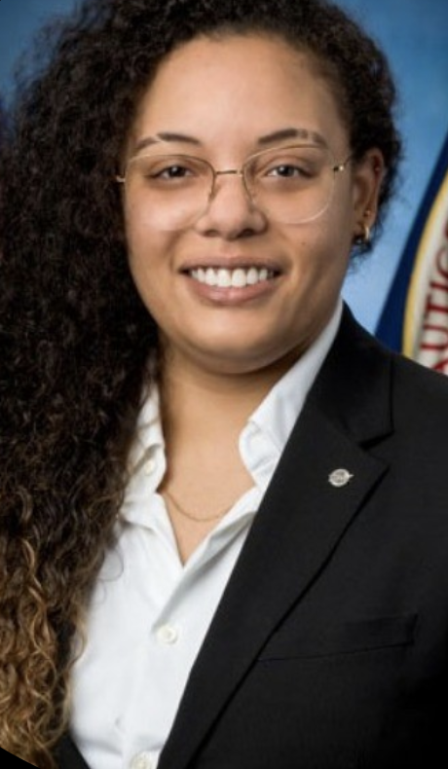
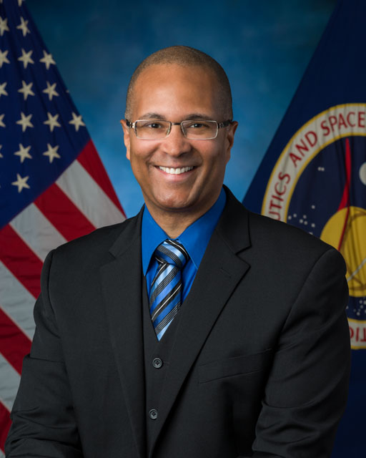
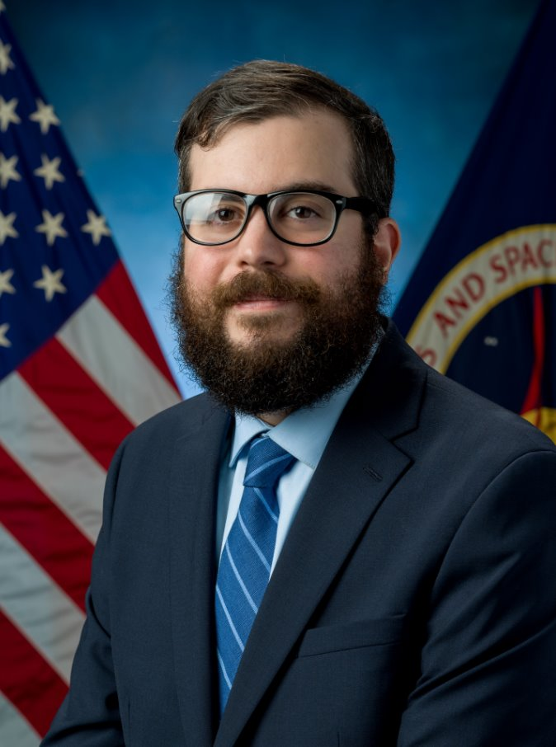
Sponsors
Sponsors:
Mina Brahmbhatt
Amy Cassady
Orion Integrated Performance Lead
Amy Fritz
JSC Dust Mitigation
Technical Lead
Brian Troutman
Human Landing System Crew Compartment Lunar Dust Mitigation Discipline Lead
Thomas Vassiliou
Notes:
Why each group is important
Dust mitigation committee, sponsors like brian and Thomas, team 516 (like how we will be hands on), the companies and their importance, advisors and stakeholders inportance

Slide 4
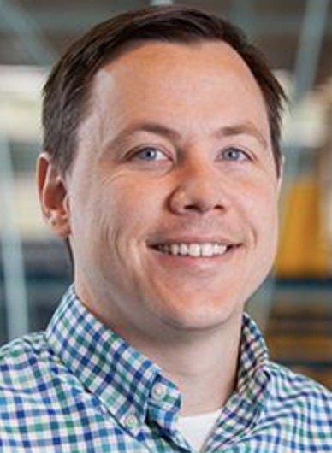
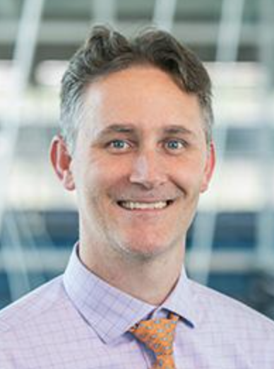
Advisors
Advisors:
Mina Brahmbhatt
Dr. Brandon Krick
Associate Professor
Dr. Shayne McConomy
Teaching Faculty II

Slide 5
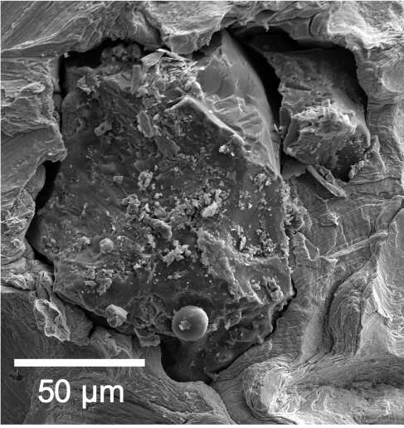
What is Lunar Dust?
What is Lunar Dust?
Mina Brahmbhatt
Fine particles of the lunar regolith
Average Size is ~100 µm
Average Density is 1.5 g/cm³

Slide 6
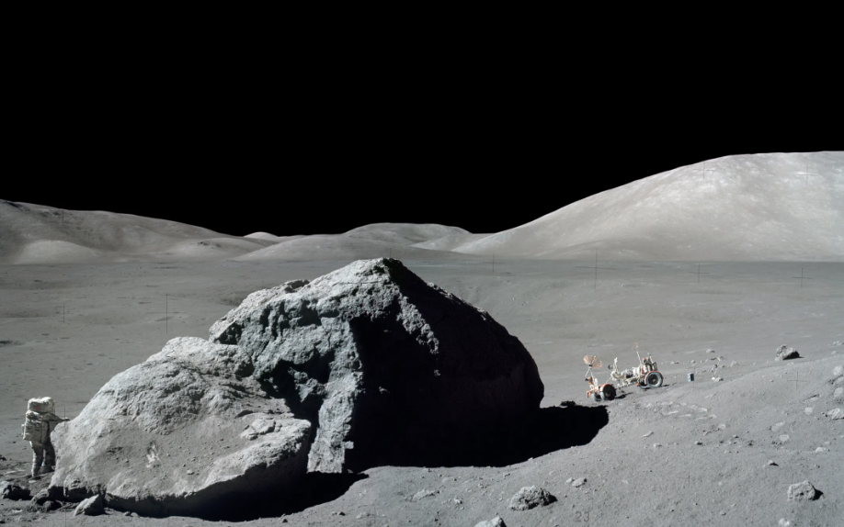
"I think dust is probably one of the greatest inhibitors to a nominal operation on the Moon"
-Apollo 17 Commander Gene Cernan
Mina Brahmbhatt

Slide 7







The Dust Problem
The Dust Problem:
Mina Brahmbhatt
Effects and Issues
Human Health Toxicology
Clogging Joints and Mechanisms
False Instrument Readings
Abrasion of Surfaces
Vision Obstruction
Failure of seals
Thermal Control

Slide 8

Project Expectations
Project Expectations:
Mina Brahmbhatt
The Big Idea
This project will further the research for NASA's upcoming Artemis III mission in 2026 and help in the understanding of lunar dust mitigation & composition.
Notes:
The big question slide with an over view of expectations (like what we have in functional decomposition)

Slide 9
Project Expectations:
Challenges
Project Expectations:
Nia Britton
Challenges
Challenge 1:
Applying and understanding CFD use in this project
Challenge 2:
Maintaining consistency from batch to batch
Challenge 3:
Lunar dust simulant clumping
Challenge 4:
Dust is sensitive to electric fields
Challenge 5:
Comparing sizes of lunar dust simulant and fluorescent add ins
Challenge 6:
Differentiating lunar dust simulant from fluorescent add ins during and post-testing
Notes:
CHALLENGES SLIDE:
Challenge 1:
Possible issues with liunar dust simulant clumping, have made plans to bake at certain temp for certain amount of time to mitigate the issue
Challenge 2:
Maintain consistency from batch to batch, an issue that nasa has had themselves and warned us about, need to plan for and understand how to incorporate the possibility of slightly different results each time into our findings
Challenge 3:
Mistaking fluorescent add ins for lunar simulant during the viewing process, again dust is very small and hard to see and we don’t want to mistake one for another; can pay attention to the color characteristics of each dust option and be intinonal on having a completely opposite color for our fluorescent, will help increase visability
Challenge 4:
Comparison of lunar dust simulant and fluorescent add ins in particle size, will be difficult and may force us to settle on identical densities
Challenge 5: understanding and incorporating CFD software, very this real world application is slightly ambiguous, different from college class problems, we are creating the problem and solution on our own, starting from stratch
DUST IS SENSITIVE TO ELECTRIC FIELD ISSUE:
Should use conductive tuding so we reduce electrostatic forces, and try to mitigate dust sticking to the walls

Slide 10
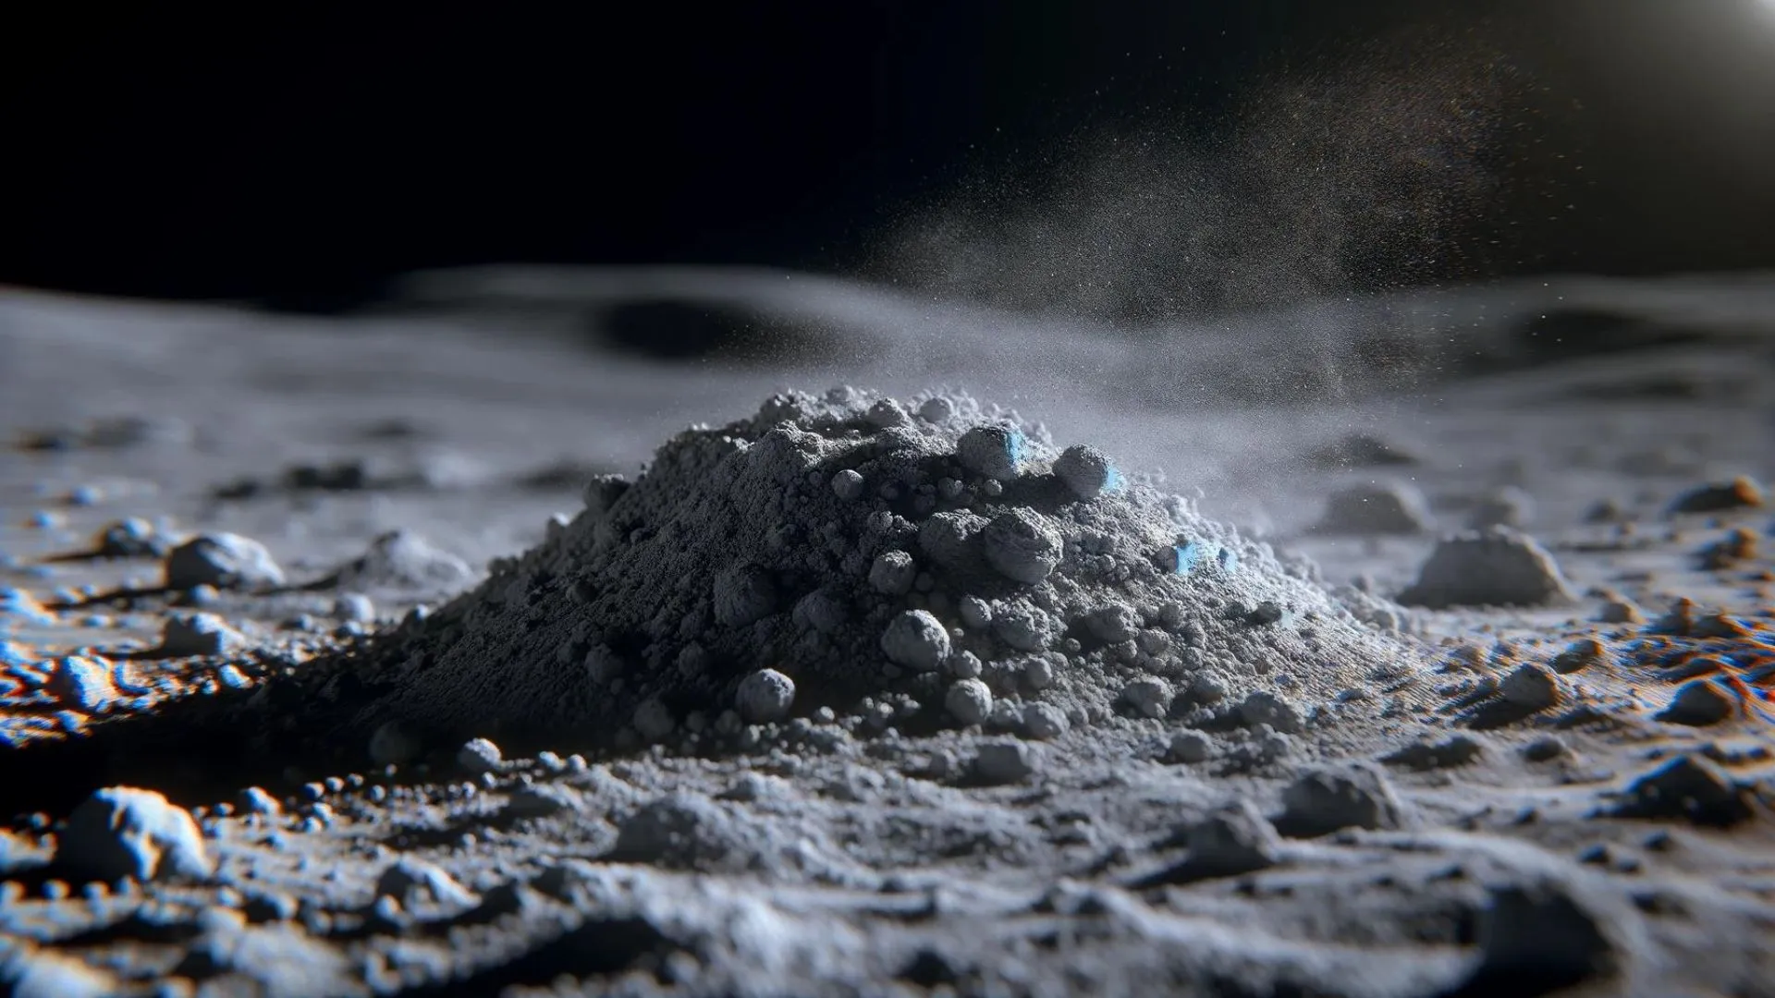
Project Expectations
Project Expectations:
Nia Britton
Background
Varying material properties
Dust can damage anything
Lunar glove box for even dispersing
Notes:
PROJECT BACKGROUND SLIDE:
Lunar dust presents a different challenges due to having various material properties
When aerosolized with the air, lunar dust can damage hardware
NASA already has a working lunar glovebox yet it does not perform optimally
Presents unique challenges
Varying material properties.
Lunar dust can damage hardware
Sponsors have working lunar glovebox
Does not perform optimally

Slide 11





Project Expectations:
Key Goals
Project Expectations:
Nia Britton
Key Goals
Model Dust and Airflow Characteristics
Experiment with Lunar Dust Simulant
Construct Glovebox
Compare Results
Fan Position

Slide 12
Project Expectations:
Assumptions
Project Expectations:
Nia Britton
Assumptions
Team 516's prototype will be based on a pre-existing prototype by NASA
The lunar dust simulant chosen will be similar in density and sizing to lunar dust
Electrostatics, simulant erosion, and moisture effects are neglected
Less than 0.5 wt% water in the glove box
Any hardware to be tested will be provided by sponsors

Slide 13

Technical Details and Constraints:
Simulation Formation
Technical Details and Constraints:
Nia Britton
Simulation Formation
Tangible Simulation
Construct the glovebox
Match NASA's dimensions
Earth Conditions
Virtual Simulation
Use CAD of glovebox
Computational Fluid Dynamics
Earth Conditions
Results
Notes:
A short blurb about how we wanna visualize and use the matlab density image calculation stuff that mina was talking about, and how we will use cfd, and and how our testing environment will compare to the environment/ simulate the environment its designed for
-how virtual results should match the tangible glovebox results

Slide 14
Technical Details and Constraints
Technical Details and Constraints:
Nia Britton
Customer Needs
Question​ | Customer Statement​ | Interpreted Need​
What is the intended use?​ | Engineer a glovebox for various concepts.​ | Design a versatile glovebox for space testing.​
How to choose the simulant?​ | Base on particle density for lunar data.​ | Select simulant within 10 microns of lunar dust data.​
Testing approach?​ | Prototype in the first semester and use CFD modeling.​ | Create a virtual simulation and physical prototype.​
Size requirements?​ | Dimensions are 3 ft x 2 ft x 2 ft.​ | Build glovebox to specified dimensions.​
Notes:
The major customer needs from the original vdr should go here

Slide 15
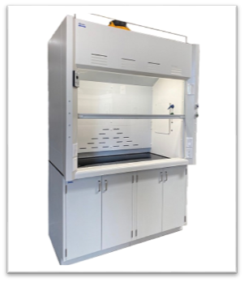
Technical Details and Constraints
Technical Details and Constraints:
Nia Britton
Other Specifications
Considering using two simulants
  Baseline simulant versus characteristically comparable simulant
Procedure cross over for add ins and dust simulant
  Drying out fluorescent add ins and simulant
  Ensuring similar density properties
Ventilation equipment
  Fume hoods versus other options
  Understanding dangers and capabilities
Proper and low risk dust disposal
  Human and environmental considerations
Notes:
I think this will be a compilation of important bullet points from the google doc of stuff we haven’t talked about in previous slide
ELONGATED BULLET POINTS:
Considering using two simulants, one as a base test and the other actually comparative to what will be using for immediate future missions to test
Will need to get manufacturer insight on heating the fluorescent balls with the simulant to enc=sure similar density properties and make sure we are mitigating the humidity issue
Planning to utilize a room with dehumidifiers
Need to understand the dangers and asses the capabilities of the fume hoods and be aware of possible necessity of other ventilation options
Leads to following proper low risk (human and environmental) of dust disposal
No vauccum seal or vacuum conditions for this experimentation

Slide 16
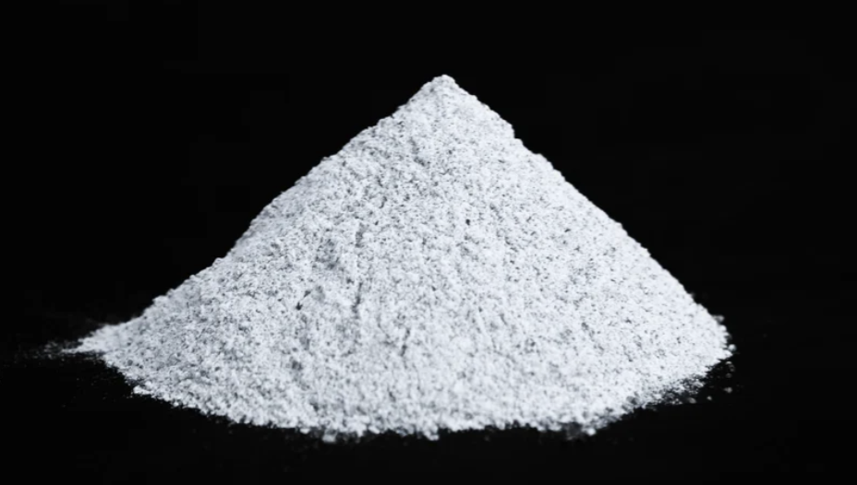
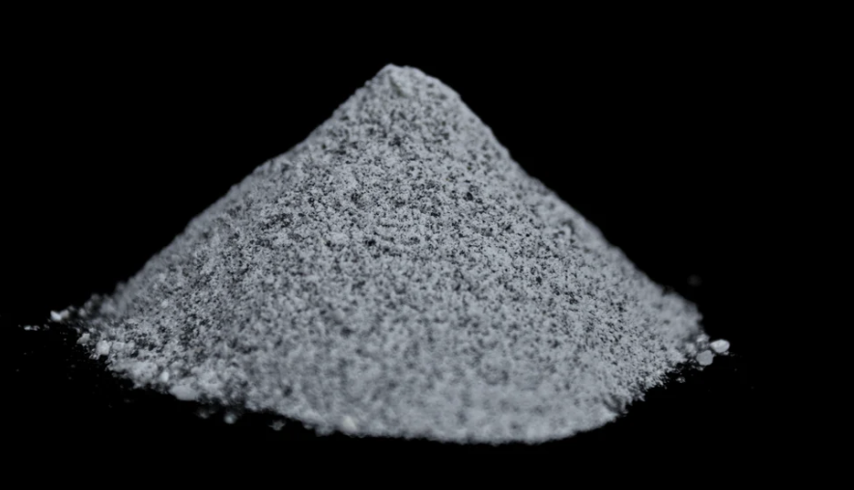

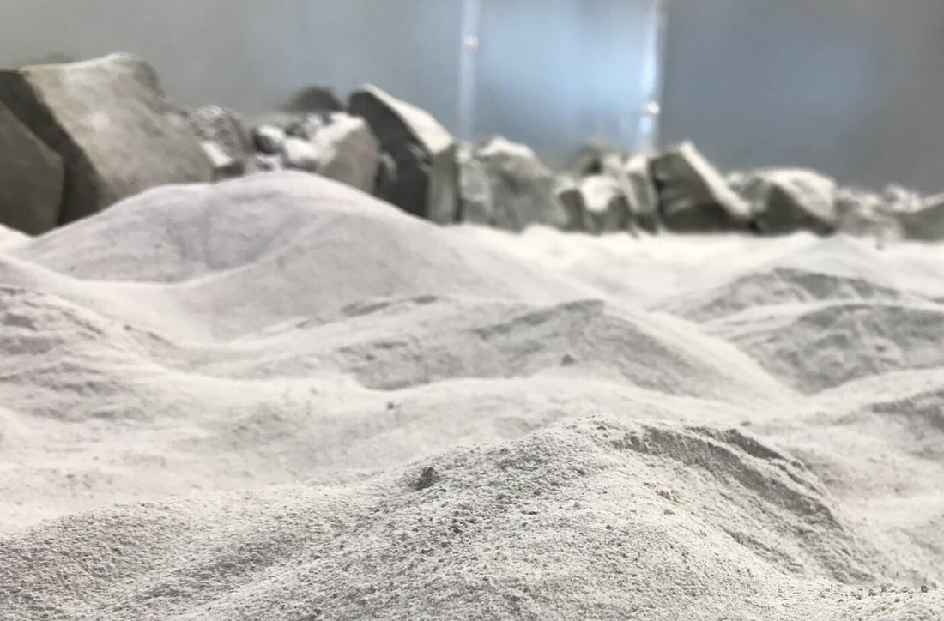
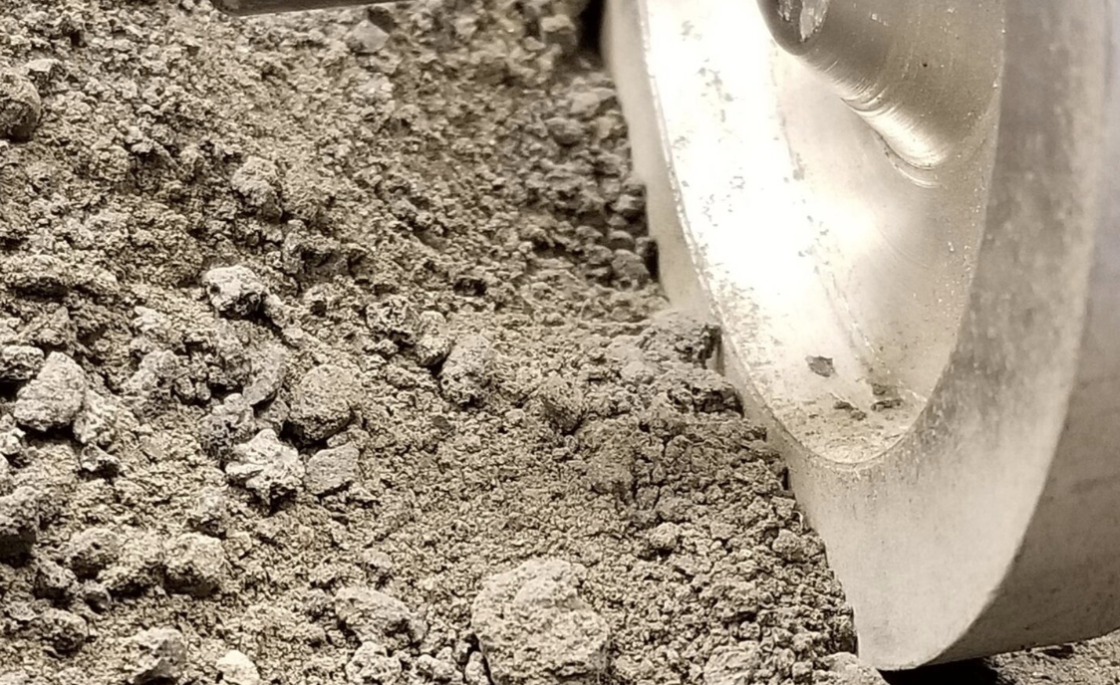
Simulant Selection
Simulant Selection:
Mina Brahmbhatt
Simulant Options
LHS-1
LHS-2
OPRH3N
OPRL2N

Slide 17

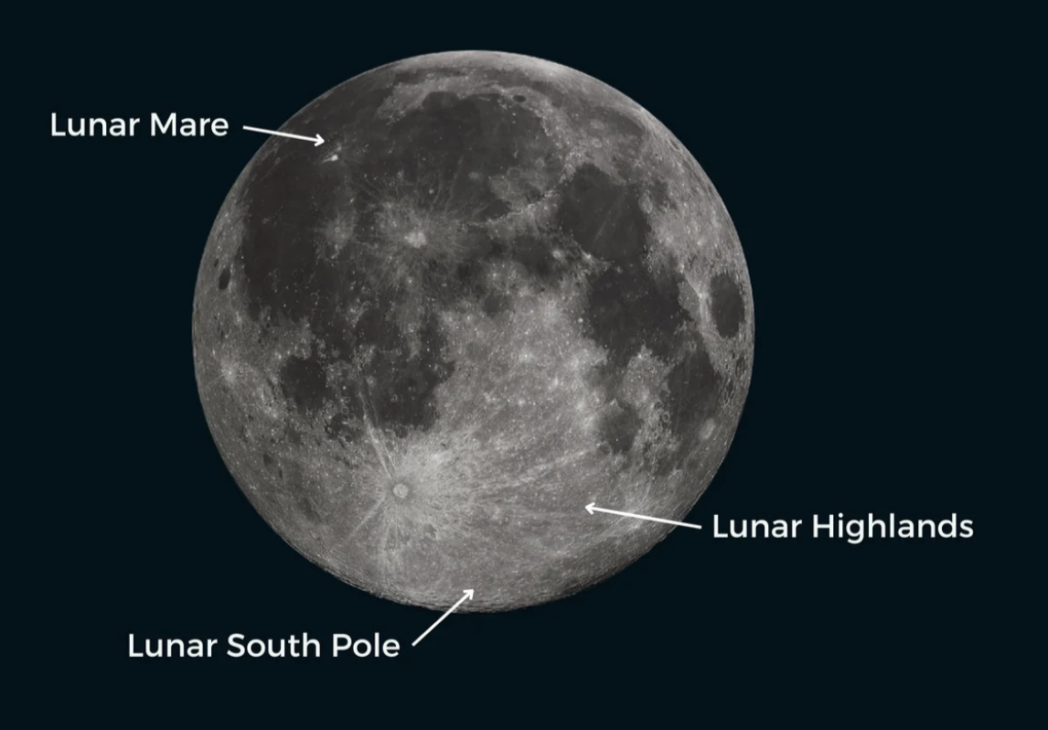
Simulant Modeled Location
Simulant Modeled Location:
Mina Brahmbhatt
Moon Locations
LHS-1
LHS-2
OPRH3N
OPRL2N

Slide 18

Simulant Selection
Simulant Selection:
Mina Brahmbhatt
Final 2 Choices
LHS-1
LHS-2
OPRH3N
OPRL2N
Notes:
LHS-2 eliminated bc over 35 microns and we want it to be small to loft in the air
OPRL2N eliminated because it is 70/30 anorthosite/basaltic cinder vs OPRH3N 80/20 ratio
Want more anorthosite because that’s highland

Slide 19
LHS-1
LHS-1:
Mina Brahmbhatt
Simulant Details
Under 35 µm
74% Anorthosite, 25% Basaltic Cinders
Bulk Density:
  Min: 1.38 g/cm³
  Max: 1.56 g/cm³
Angle of Repose:
  10g: 47 deg
  250g: 39.5 deg
Notes:
Anorthosite means particles from the light side of the moon
Particle diameter of 1mm means before the humidity is sucked out. The website says its "upper limit size" is 1mm. Meaning after it being in an oven it becomes much smaller
$45 per 1 kg
1% is ilmenite, pyroxene, olivine
Lower angle of repose means less cohesion which we want to avoid clumping in the funnel

Slide 20
OPRH3N
OPRH3N:
Mina Brahmbhatt
Simulant Details
Under 35 µm
80% Anorthosite, 20% Basaltic Cinders
Bulk Density:
  Min: 1.32 g/cm³
  Max: 1.50 g/cm³
Notes:
Basaltic cinder are particles from around the cone of volcanoes on moon. Anorthosite is light side of the moon
Don’t know the price on this one

Slide 21
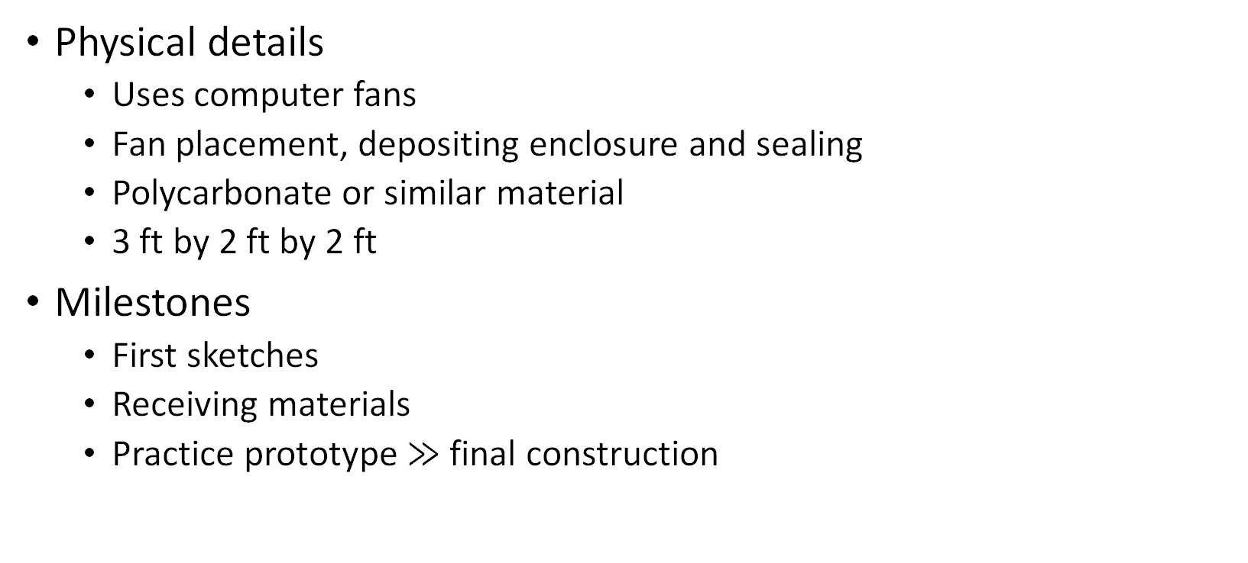
Prototyping
Prototyping:
Kendall Kovacs
Details and Milestones
Physical details
  Uses computer fans
  Fan placement, depositing enclosure and sealing
  Polycarbonate or similar material
  3 ft by 2 ft by 2 ft
Milestones
  First sketches
  Receiving materials
  Practice prototype $≫$ final construction
Notes:
BASIC SLIDE CONTENT:
A little description for what porotype nasa already has, what we are going to physically build, the timeline details (starting in first of second semester), reiterate issues with previous prototype and how we plan to fix it (fan placement), all the physical prototype stuff, and rebring up dimension stuff
Sponsor wants us to/suggests we start prototyping in the first semester
Strong and see thru material for abrasive testing simulant
Our team will begin building a prototype using the physical details from NASA's existing glovebox
We are beginning our first sketches and creating a procurement log before we build our first practice prototype

Slide 22

Testing, Health, and Safety
Testing, Health, and Safety:
Kendall Kovacs
Organizations and Plans
FSU Environmental Health and Safety (EHS)
  Testing and handling will follow EHS guidelines and restrictions
  Safety data sheets for hazardous materials
High Performance Material Institute (HPMI)
  Intended location for testing
Proper PPE will be used (gloves, safety goggles, masks, etc.)
Two test runs will be performed per simulant used
Notes:
Because the lunar dust can be dangerous to work with and dispose of, our team is using the safety data sheets for hazardous materials and working with FSU EHS and HPMI to ensure we have a proper testing environment as well personal protective equipment, and follow all giudelines during all four test runs

Slide 23
Functional Decomposition
Functional Decomposition
Kendall Kovacs
Glovebox
Experiment
Electronics
Simulant Entrance
Simulation
Models Air Flow
Enclosure
Computer Fans
Switch
Circulates Air
Lofts Simulant
Maintains Steady Air Flow
Turns fans on
Turns fans off
Wires
Provide power from outside of enclosure
Funnel Mechanism
Can be resealed
Deposits Simulant
Mounts to glovebox
Allows visibility
Remains Stable
Seals Contents
Models Particle Distribution
Calculates air velocity
Calculates air angle
Determines fan position
Visualizes particle position
Calculates volumentric loading
Minimizes vibrations
Minimizes humidity allowances
Minimizes allowances of non-simulant particles
Simulant
Visualizes particle position
Density similar to lunar dust
Simulates lunar dust behavior

Slide 24
Functional Decomposition
Functional Decomposition
Kendall Kovacs
Glovebox
Experiment
Simulation
Models Air Flow
Models Particle Distribution
Electronics
Simulant Entrance
Enclosure
Simulant
Calculates air velocity
Visualizes particle position
Funnel Mechanism
Can be resealed
Allows visibility
Remains Stable
Seals Contents
Visualizes particle position
Density similar to lunar dust
Calculates air angle
Calculates volumentric loading
Deposits Simulant
Minimizes vibrations
Minimizes humidity allowances
Simulates lunar dust behavior
Determines fan position
Computer Fans
Mounts to glovebox
Minimizes allowances of non-simulant particles
Circulates Air
Switch
Wires
Lofts Simulant
Turns fans on
Provide power from outside of enclosure
Maintain Steady Air Flow
Turns fans off

Slide 25
Functional Decomposition
Functional Decomposition
Kendall Kovacs
Glovebox
Experiment
Electronics
Simulant Entrance
Simulation
Models Air Flow
Enclosure
Computer Fans
Switch
Circulates Air
Lofts Simulant
Maintains Steady Air Flow
Turns fans on
Turns fans off
Wires
Provide power from outside of enclosure
Funnel Mechanism
Can be resealed
Deposits Simulant
Mounts to glovebox
Allows visibility
Remains Stable
Seals Contents
Models Particle Distribution
Calculates air velocity
Calculates air angle
Determines fan position
Visualizes particle position
Calculates volumentric loading
Minimizes vibrations
Minimizes humidity allowances
Minimizes allowances of non-simulant particles
Simulant
Visualizes particle position
Density similar to lunar dust
Simulates lunar dust behavior

Slide 26
Functional Decomposition
Functional Decomposition
Kendall Kovacs
Glovebox
Experiment
Electronics
Simulant Entrance
Simulation
Models Air Flow
Enclosure
Computer Fans
Switch
Circulates Air
Lofts Simulant
Maintains Steady Air Flow
Turns fans on
Turns fans off
Wires
Provide power from outside of enclosure
Funnel Mechanism
Can be resealed
Deposits Simulant
Mounts to glovebox
Allows visibility
Remains Stable
Seals Contents
Models Particle Distribution
Calculates air velocity
Calculates air angle
Determines fan position
Visualizes particle position
Calculates volumentric loading
Minimizes vibrations
Minimizes humidity allowances
Minimizes allowances of non-simulant particles
Simulant
Visualizes particle position
Density similar to lunar dust
Simulates lunar dust behavior

Slide 27
Functional Decomposition
Functional Decomposition
Kendall Kovacs
Glovebox
Experiment
Electronics
Simulant Entrance
Simulation
Models Air Flow
Enclosure
Computer Fans
Switch
Circulates Air
Lofts Simulant
Maintains Steady Air Flow
Turns fans on
Turns fans off
Wires
Provide power from outside of enclosure
Funnel Mechanism
Can be resealed
Deposits Simulant
Mounts to glovebox
Allows visibility
Remains Stable
Seals Contents
Models Particle Distribution
Calculates air velocity
Calculates air angle
Determines fan position
Visualizes particle position
Calculates volumentric loading
Minimizes vibrations
Minimizes humidity allowances
Minimizes allowances of non-simulant particles
Simulant
Visualizes particle position
Density similar to lunar dust
Simulates lunar dust behavior

Slide 28
Functional Decomposition
Functional Decomposition
Kendall Kovacs
Glovebox
Experiment
Electronics
Simulant Entrance
Simulation
Models Air Flow
Enclosure
Computer Fans
Switch
Circulates Air
Lofts Simulant
Maintains Steady Air Flow
Turns fans on
Turns fans off
Wires
Provide power from outside of enclosure
Funnel Mechanism
Can be resealed
Deposits Simulant
Mounts to glovebox
Allows visibility
Remains Stable
Seals Contents
Models Particle Distribution
Calculates air velocity
Calculates air angle
Determines fan position
Visualizes particle position
Calculates volumentric loading
Minimizes vibrations
Minimizes humidity allowances
Minimizes allowances of non-simulant particles
Simulant
Visualizes particle position
Density similar to lunar dust
Simulates lunar dust behavior

Slide 29
Ongoing and Future Work
Ongoing and Future Work
Kendall Kovacs
Budget Report
Ordering Simulant and Long Order Time Materials
Pre PDR
CFD Simulations
Notes:
Just completed Preliminary Design REview with NASA to make sure we are on track and received great positive feedback, we are finishing up the budget report, starting our CFD simulations, and ordering materials

Slide 30
Closing
Closing
Kendall Kovacs
“Safety should never be a priority. It should be a precondition” — Paul O’Neill
Major components of project
  Virtual simulation and physical construction
Safety
  Core of project
  High standards set by sponsor and team
Beyond the grade
  Passion for project
  Sponsor guide and understanding
Notes:
Reiteriate that the jist of the project will be the simulation (virtual) and the construction (physical) elements
Talk about how safety is at the core of our project and how high safety standards are set for us by nasa (environmental and personal)
Were are glad to be working on a project we are so passionate about
One of the most successful CEO's is Paul Oniel, who's main priority was the safety of his workers, which in turn became a main contributor of the company's success. Our team is following his advice and making safety a precondition for our team for both major components of our project.

Slide 31
Opening the Floor
Opening the Floor
Kendall Kovacs
Time for any questions or feedback!

